Slide 1
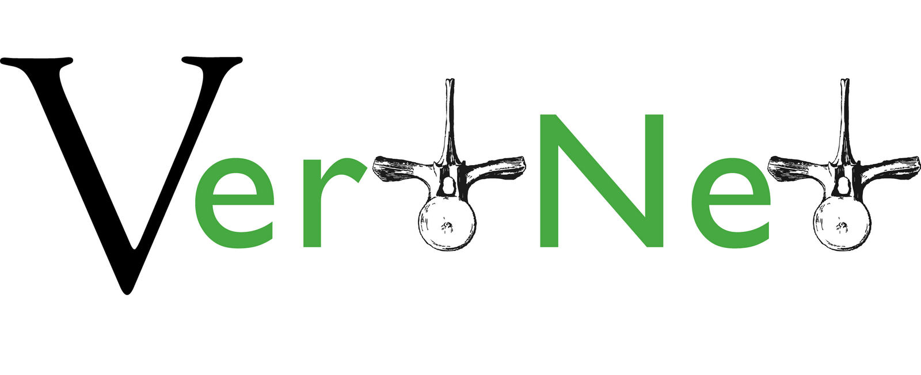
Building a Data Sharing Community

Slide 2


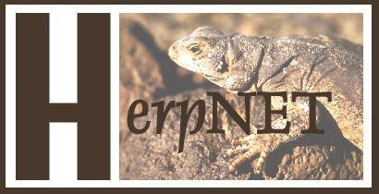


The Vertebrate Networks
In collaboration with

Slide 3
Primary Goals
Facilitate open access to specimen data on the web
Enhance the value of specimen collections
Conserve curatorial resources
Use a design easily adapted by other disciplines with similar needs

Slide 4
Critical Challenge #1
Performance

Slide 5
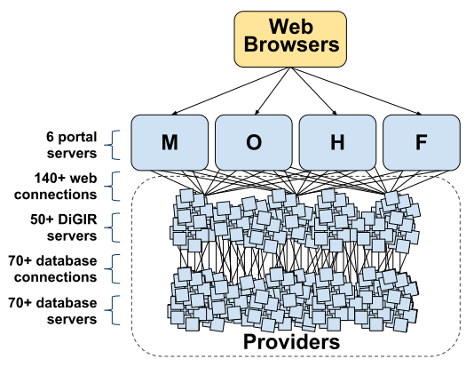
Critical Challenge #1

Slide 6
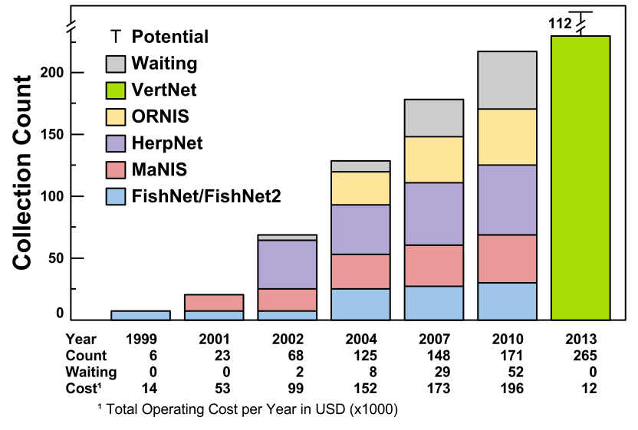
Critical Challenge #1

Slide 7
Critical Challenge #2
Performance
Aggregation

Slide 8
Critical Challenge #3
Performance
Aggregation
Costs and Sustainability

Slide 9

Critical Challenge #3
~ $200k annually reduced to ~ $20k annually

Slide 10
Critical Challenge #3
All you need is a Darwin Core Archive
Create your DwC-A or we'll do it for you
Publish it yourself or we'll host it for you
No servers, no extra IT expertise needed
Easy

Slide 11
Critical Challenge #4
Performance
Aggregation
Costs and Sustainability
Technological Integration

Slide 12
Critical Challenge #4
Big Data
157+ institutions + 377+ collections
= ~100M records and growing
Technical Challenge:
Downloading, aggregating, caching, and serving these data from the cloud
Technical Solution:
"Gulo": aggregates archives in the cloud
Notes:
VertNet software that's responsible for taking a bunch of Darwin Core Archives and getting them into CartoDB. But how? All it takes is 4 easy steps!

Slide 13
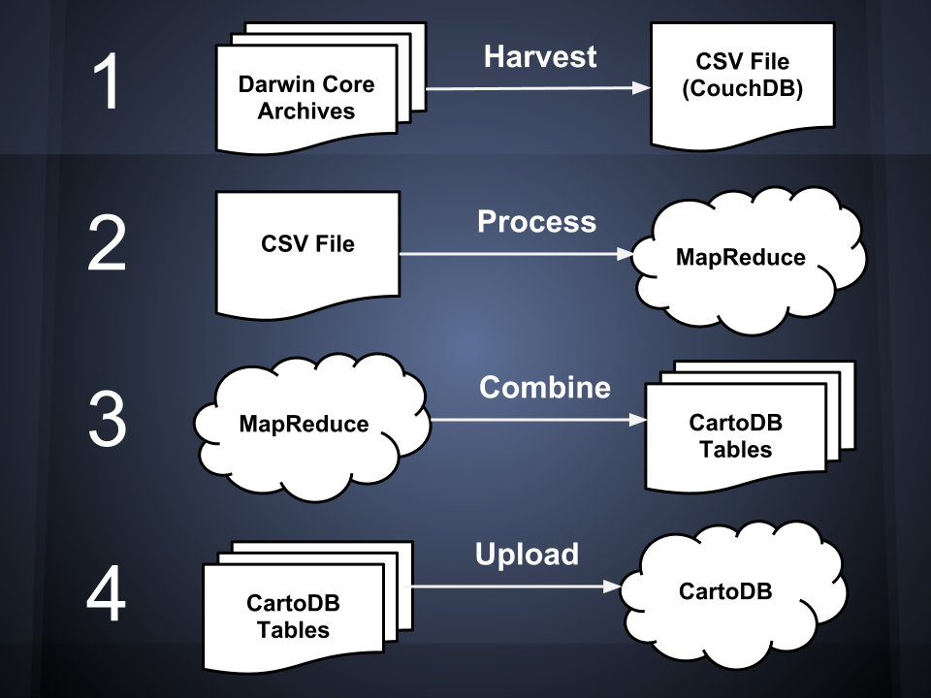
Notes:
Gulo is VertNet software that's responsible for taking a bunch of Darwin Core Archives and getting them into CartoDB. But how? All it takes is 4 easy steps!
Step 1. Gulo downloads hundreds or Darwin Core Archives from all over the world, extracts the Darwin Core records from them, and saves everything into a huge CSV file. We estimate each record is roughly 1.2 kilobytes, so this file will be around 300 GB to start.
Step 2. Next we process the records in the CSV file using MapReduce workflows. MapReduce is a technique that lets us break apart the file into lots of small pieces and process them in parallel on a cluster of several computers. We do this because it's really slow processing 300GB on a laptop! Right now we're processing on the Amazon cloud and we're also working with GBIF to use their cluster as well.
Step 3. OK, so now our records are scattered across a cluster of MapReduce computers. In step 3, we combine them into a set of CartoDB tables. Currently we have four tables: The occurrence table which basically just contains all the original records, a location table that contains all unique coordinates, a taxonomy table with all unique scientific names, and a location-taxonomy table that links coordinates with scientific names.
Step 4. The last step is easy. Upload the tables to CartoDB. After this step, VertNet data is ready for map tiling and querying.
db - Indexes to optimize querying in CartoDB

Slide 14
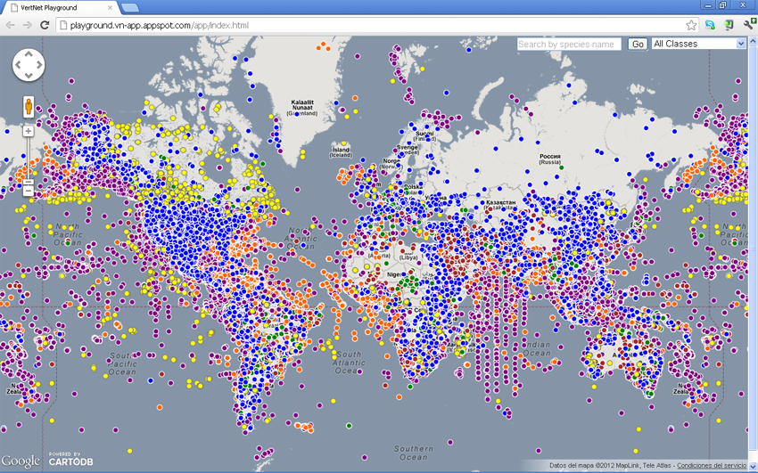
Visualization: VertNet & CartoDB

Slide 15
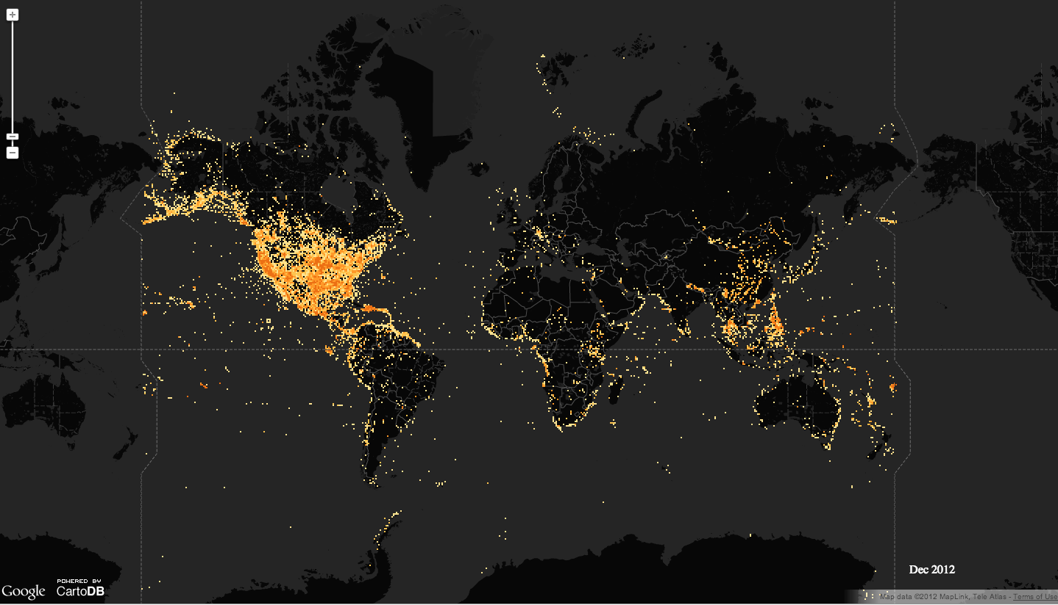
Opening Doors to Innovation

Slide 16
Progress So Far...
32 institutions (79 collections) are up
19 institutions (44 collections) in process
106 institutions (228 collections) waiting
In CartoDB to date (44 archives):
3,367,773 records processed
1,606,374 mappable records
228,270 distinct, mappable coordinates
162,077 distinct scientific names

Slide 17
Moving Forward
2012-2013:
Finish transitioning current networks into VertNet
2012-2013: Develop User Interface for data searching
2012-2013: Integrate with other partners and projects
2013-2014:
Develop tools for visualization, discovery, and improvement (annotations, thesaurus, phylogenetic browser)
Sustainability Workshop
Notes:
partners/projects include Collection Management Systems (Arctos, Specify), EOL, AmphibiaWeb, Map of Life, NEOMAP...

Slide 18
Dave Bloom - VertNet Coordinator
dbloom@vertnet.org
Laura Russell - VertNet Programmer
larussell@vertnet.org
Carla Cicero - VertNet PI
ccicero@berkeley.edu

Slide 20
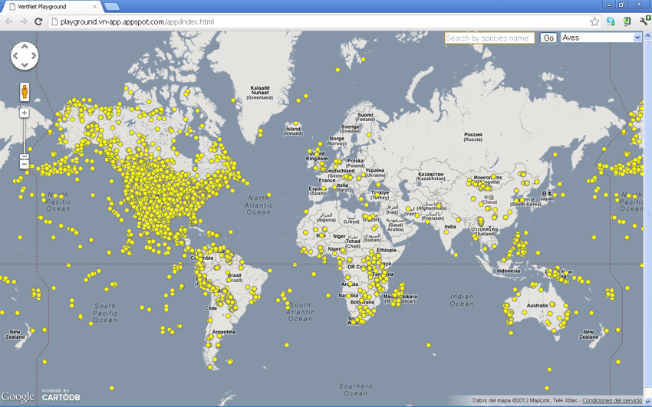
All Aves

Slide 21
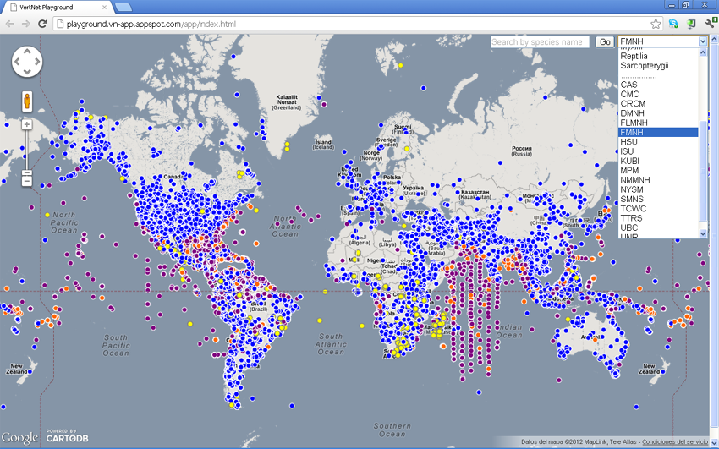
Field Museum of Natural History

Slide 22
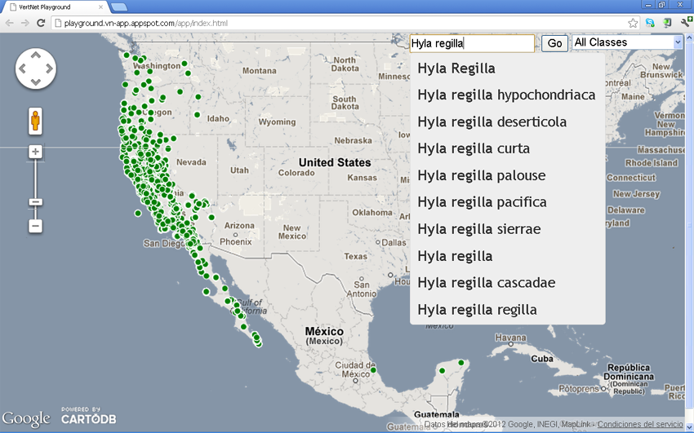
Hyla regilla

Slide 23
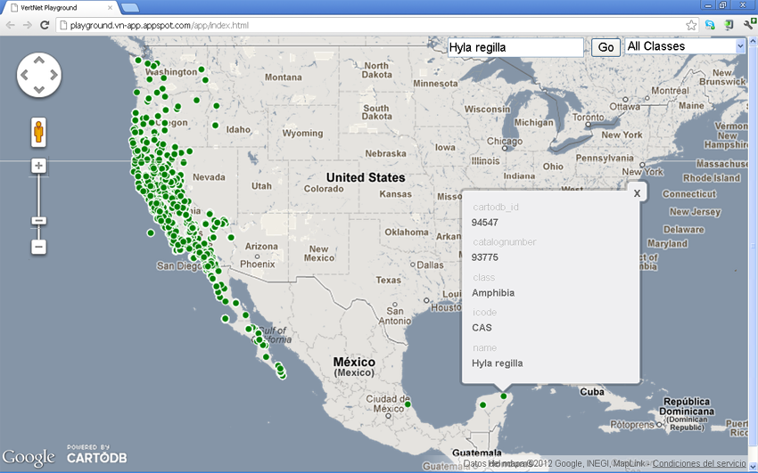
Hyla regilla

